Slide 1
FL Regional STEM2 Hub
CIS-S Outcomes - Statistical Analysis

Slide 2
Sample
December 2022 - February 2023
1317 Students in Grades 4 - 12
11 Putnam County Schools
Tool
Retrospective Pretest-Posttest
Grades 4-5: CIS-S Option 2
Grades 6-12: CIS-S Option 4 (Full Suite)

Slide 3
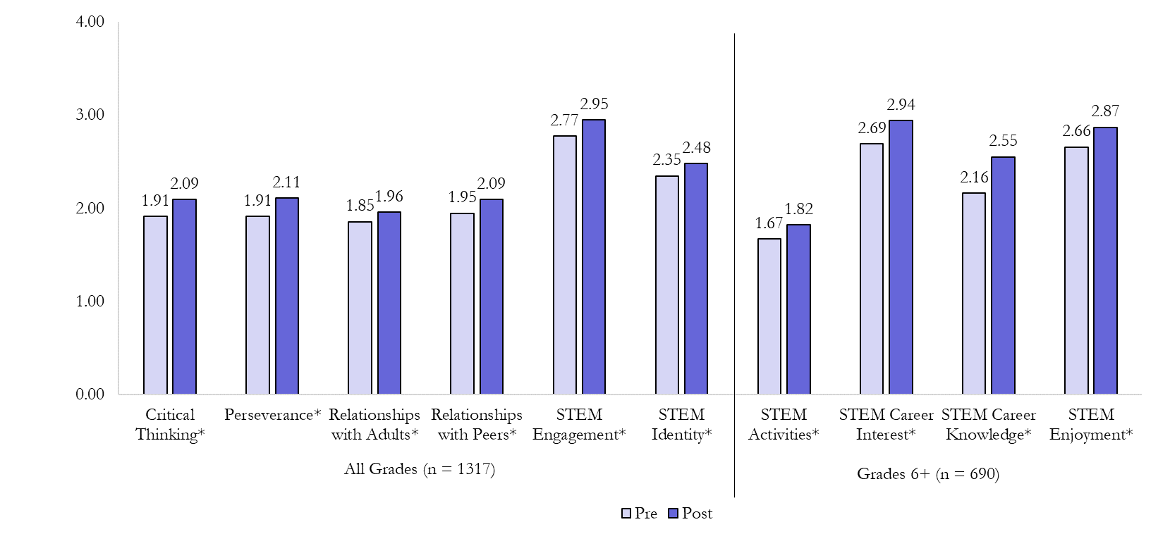
Overall, students reported significant positive change on all 10 scales (p’s < 0.05).

Slide 4
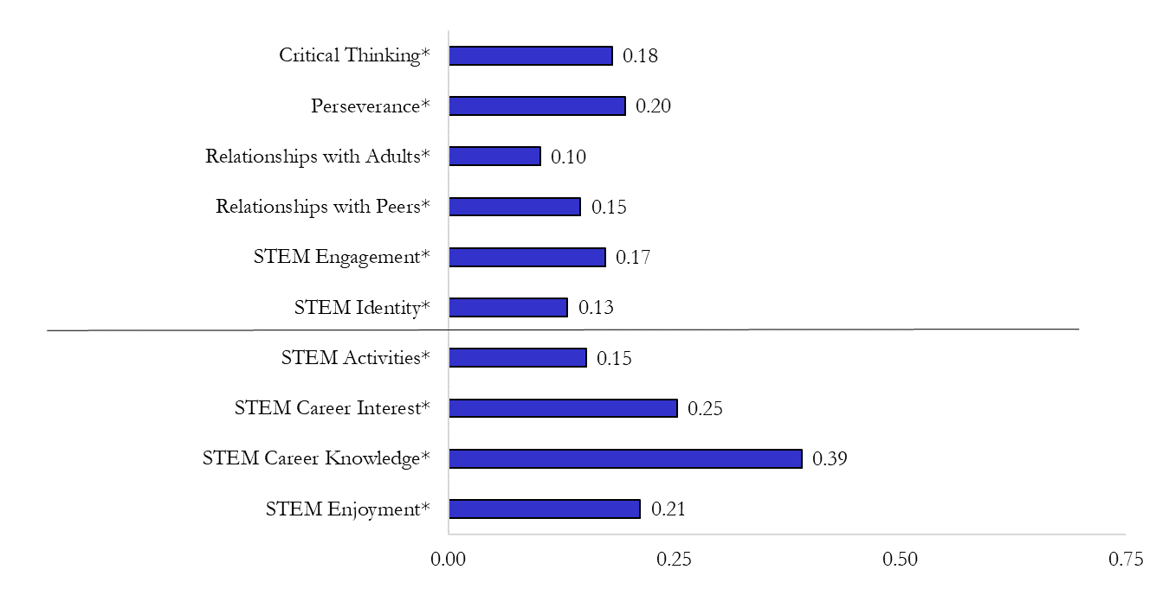
Overall, students reported significant positive change on all 10 scales (p’s < 0.05).
All Grades
(n = 1317)
Grades 6+
(n = 690)

Slide 5
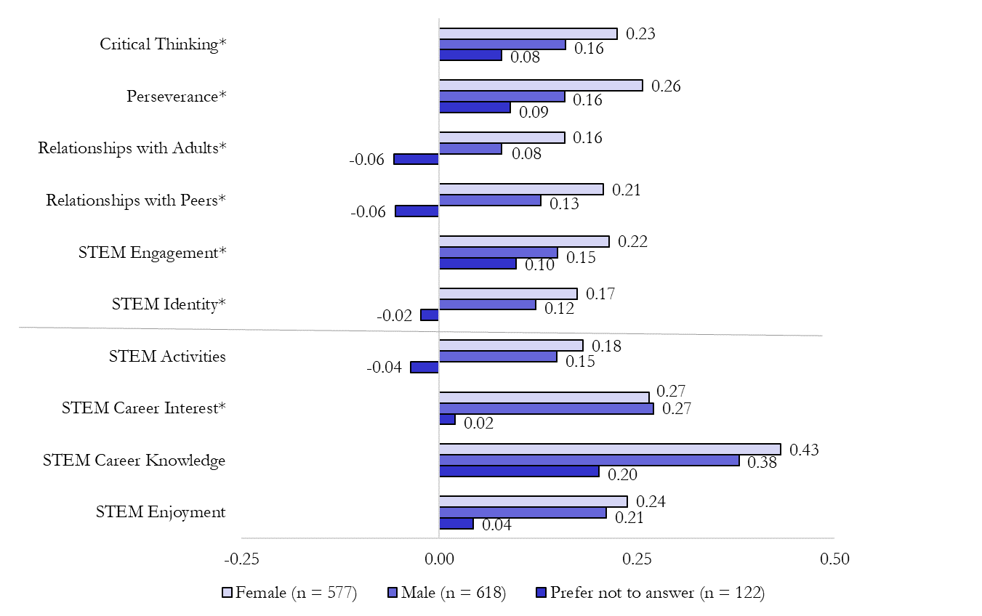
Across gender, students reported significant differences on 7 scales (p’s < 0.05).
Notes:
Between Group
All genders: sig differences on 7 scales
STEM engagement, STEM identity, STEM career interest, critical thinking, perseverance, relationships with adults, relationships with peers
Female/Male only: sig diffs on 5 scales
STEM engagement, critical thinking, perseverance, relationships with adults, relationships with peers
Within Group:
Males (n = 618): Sig diffs (p’s < 0.05) on all 10 scales (all pos)
Females (n = 577): Sig diffs (p’s < 0.05) on all 10 scales (all pos)
Prefer not to answer (n = 122): No sig diffs on any scales

Slide 6
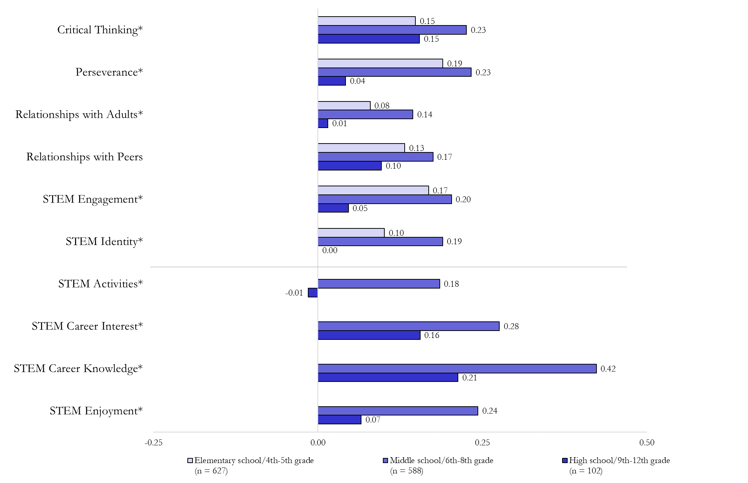
Across grade levels, students reported significant differences on 9 scales (p’s < 0.05).
Notes:
Between Group:
Sig diffs on 9 scales
STEM engagement, STEM identity, STEM enjoyment, STEM career knowledge, STEM career interest, STEM activities, critical thinking, perseverance, relationships with adults.
Within Group:
4th-5th (n = 627): sig diffs (p’s < 0.05) on all 6 scales (all pos)
6th-8th (n = 588): sig diffs (p’s < 0.05) on all 10 scales (all pos)
9th-12th (n = 102): sig diffs (p’s < 0.001) on 2 scales - STEM career knowledge & critical thinking (pos)
No sig diffs on STEM activities, STEM career interest, STEM engagement, STEM enjoyment, STEM identity, perseverance, relationships with adults, relationships with peers.

Slide 7
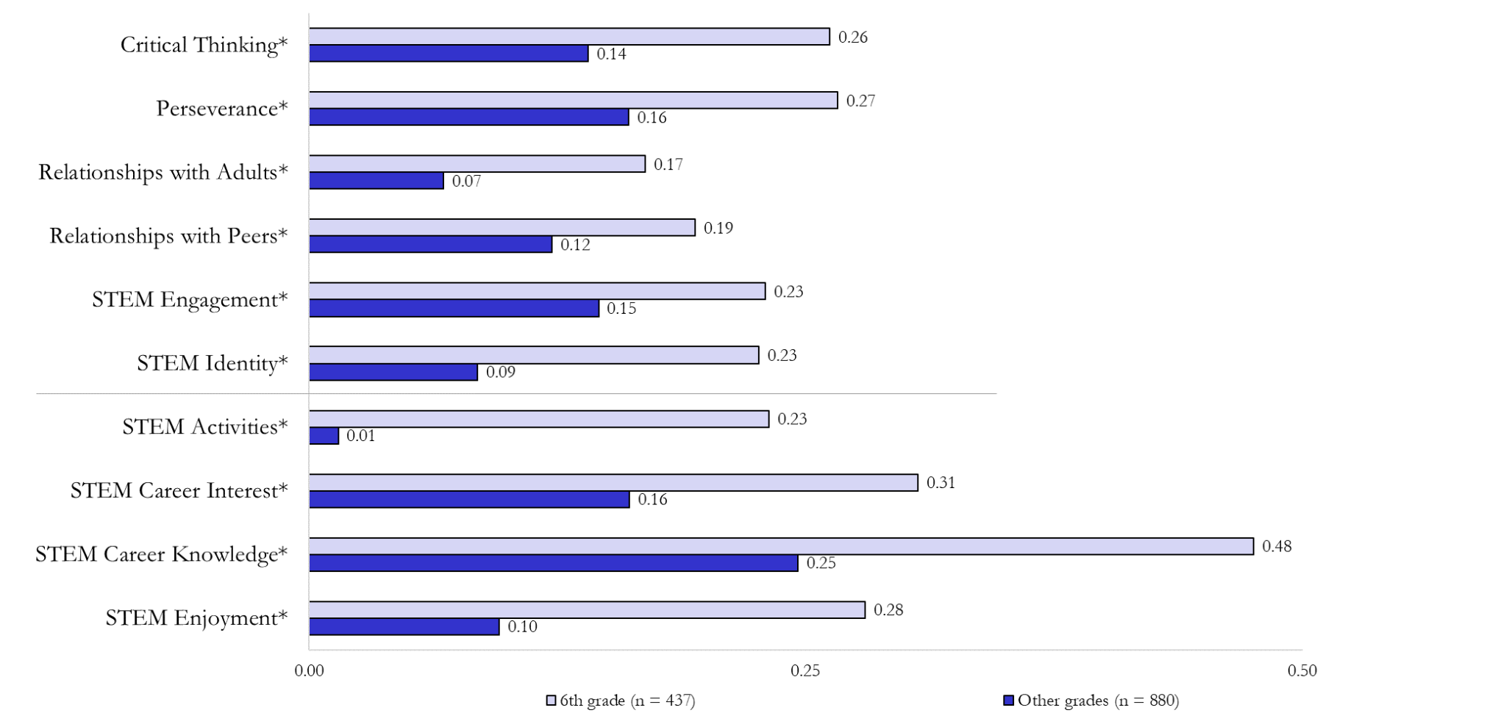
Between students in 6th grade and other grades, students reported significant differences on all 10 scales (p’s < 0.05).
Notes:
Across scales, means higher for 6th graders than non-6th graders.
6th grade: sig diffs on all 10 scales
Other grades: sig diffs on 9 of 10 scales (not STEM activities)

Slide 8
Between female students in 6th grade and 4th-5th grade, students reported…(p’s < 0.05).

Slide 9
Between male students in 6th grade and 4th-5th grade, students reported…(p’s < 0.05).

Slide 10
Across race/ethnicity groups of 6th graders, students reported significant differences on

Slide 11
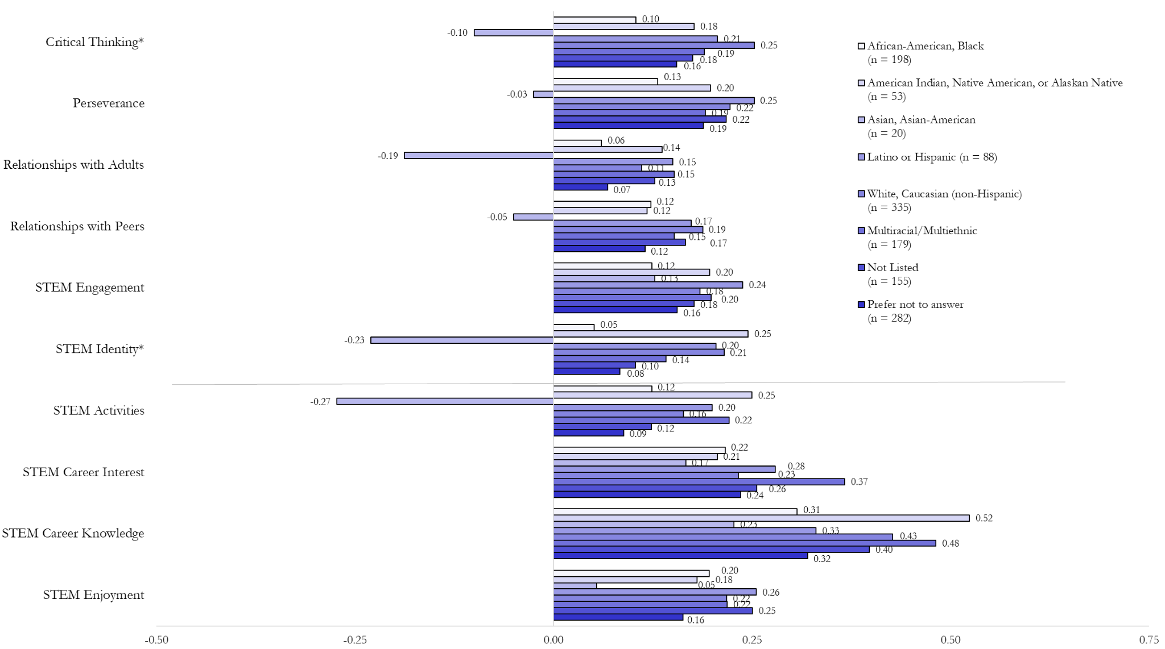
Across race/ethnicity groups, students reported significant differences on STEM identity and Critical Thinking.
Notes:
African-American Black:
Sig diffs (p’s < 0.05) on 8 scales (all pos): STEM engagement, STEM enjoyment, STEM career knowledge, STEM career interest, STEM activities, critical thinking, perseverance, relationships with peers.
No sig diffs on 2 scales: STEM identity, relationships with adults.
American Indian, Native American, or Alaskan Native:
Sig diffs (p’s < 0.05) on 6 scales (all pos): STEM engagement, STEM identity, STEM career knowledge, STEM activities, critical thinking, perseverance.
No sig diffs on 4 scales: STEM career interest, STEM enjoyment, relationships with adults, relationships with peers.
Asian, Asian-American:
No sig diffs on any of the 10 scales
Caucasian, White (non-Hispanic):
Sig diffs (p’s < 0.001) on all 10 scales (all pos)
Latino or Hispanic:
Sig diffs (p’s < 0.001) on all 10 scales (all pos)
Multiracial/multiethnic:
Sig diffs (p’s < 0.001) on all 10 scales (all pos)
Not Listed:
Sig diffs (p’s < 0.05) on 9 scales (all pos): STEM engagement, STEM identity, STEM enjoyment, STEM career knowledge, STEM career interest, critical thinking, perseverance, relationships with adults, relationships with peers.
No sig diffs on 1 scale: STEM activities
Prefer not to answer:
Sig diffs (p’s < 0.05) on 8 scales (all pos): STEM engagement, STEM identity, STEM enjoyment, STEM career knowledge, STEM career interest, critical thinking, perseverance, relationships with peers.
No sig diff on 2 scales: STEM activities, relationships with adults.

Slide 12
Across race/ethnicity groups, students reported significant differences on…

Slide 13
CIS-E Outcomes

Slide 14
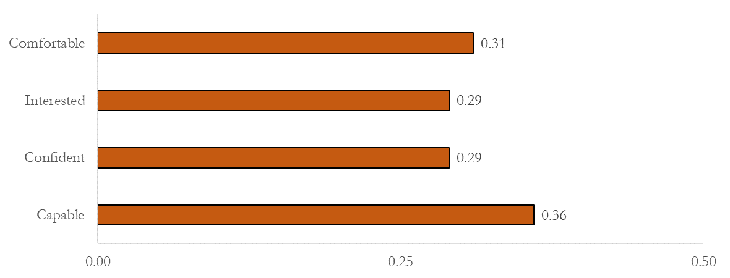
Educator Attitudes Toward Leading STEM Over Time
Difference between “One Year Ago” and “Today”

Slide 15
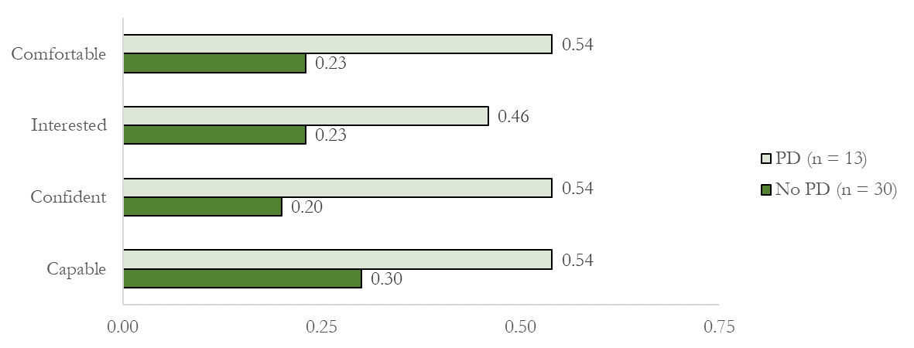
Educator Attitudes Toward Leading STEM Over Time by Professional Development Received
Difference between “One Year Ago” and “Today”
Notes:
No sig diffs

Slide 16
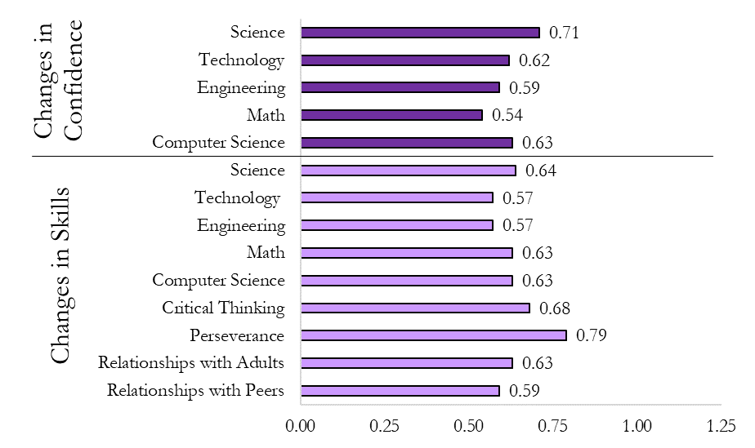
Educator Perceptions of Change in Students
Difference between “One Year Ago” and “Today”

